Slide 1



Electronic Propellant Feed System
Johnny Froehlich, Jonathan Talik, James Luce, Rawand Rasheed, Mimi Shang, Jordan Roland
Affiliations: ¹Portland State Aerospace Society, ²Maseeh College of Engineering and Computer Science Portland, OR, 97201, United States

Slide 2
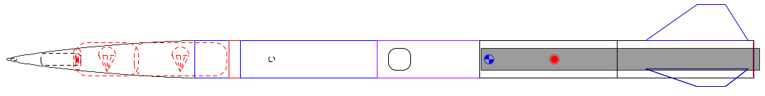
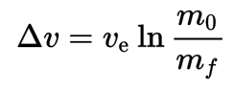
The problem
Portland State Aerospace Society (PSAS) wants its rockets to go higher.
The rocket equation dominates:
Δv = change in velocity
V_{e} = exhaust velocity
m_{o} = mass of rocket + propellant
m_{f} = mass of rocket

Slide 3
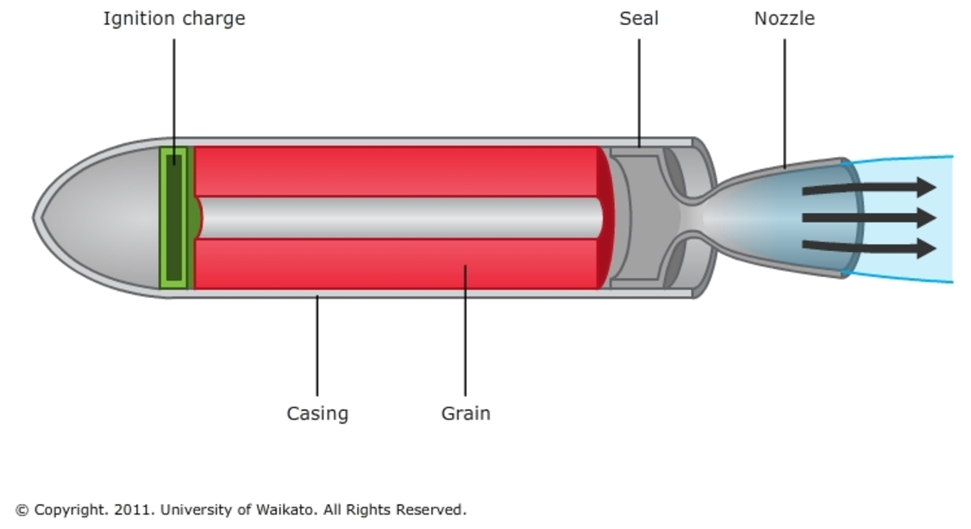
Past approach
Most small rockets use solid propellant.
Solid propellant is easy but inefficient.
Can’t throttle solid rockets= can’t insert into orbit.

Slide 4
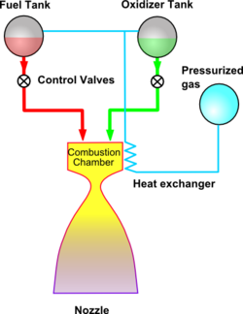
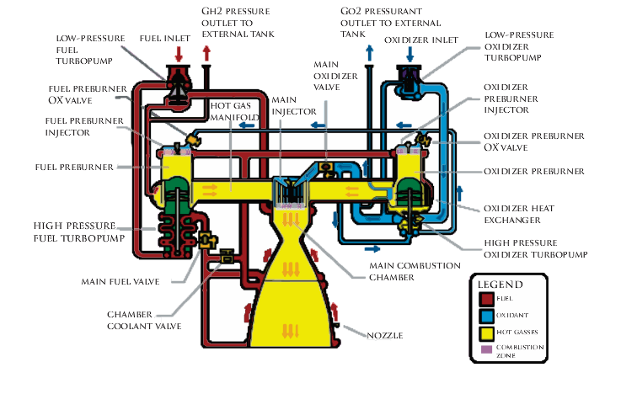
Liquid propellant
Liquid propellant gives more Δv for its mass.
Common approaches:
Pressure fed: too heavy
Turbopump: too complex
Images from wikipedia

Slide 5
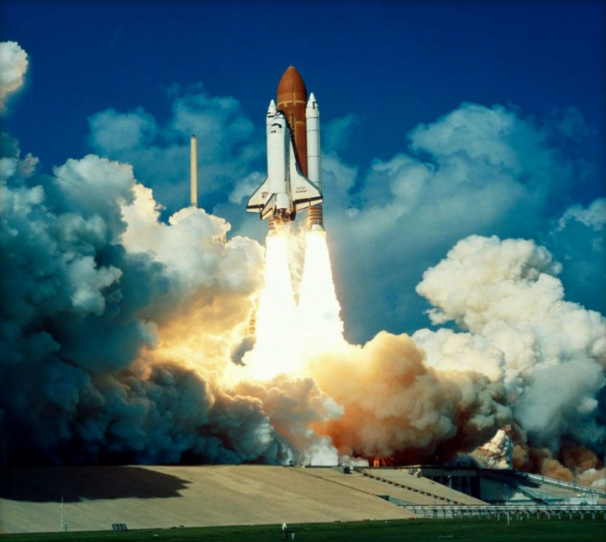
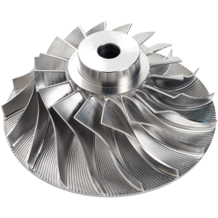
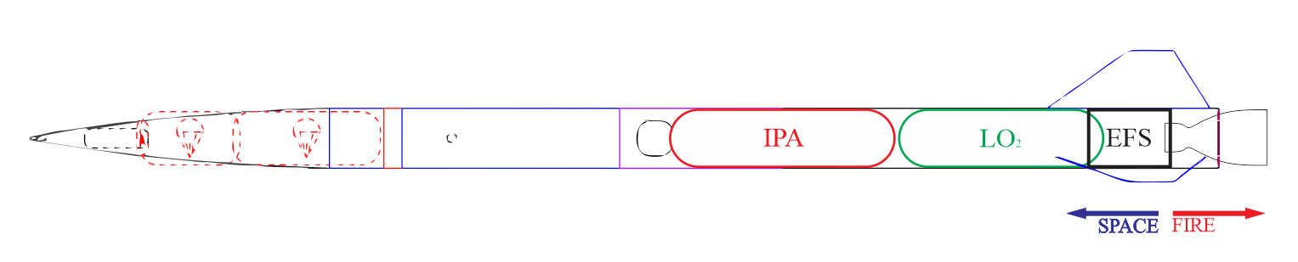
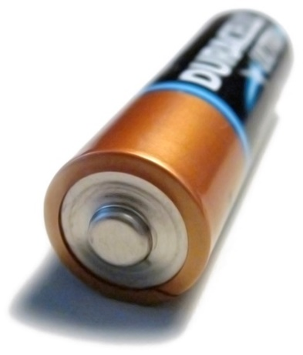
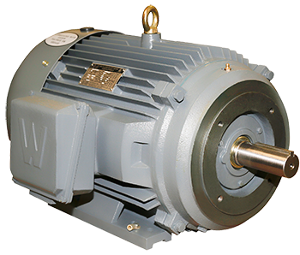
Electric motors: a new approach?
Remove the turbine from a turbopump = just a pump.
Battery energy density has been rising.
This is a new space in rocketry.
https://en.wikipedia.org/
http://www.blue-sky-technologies.com/impeller-seal-repair/
http://www.worldwideelectric.net/

Slide 6
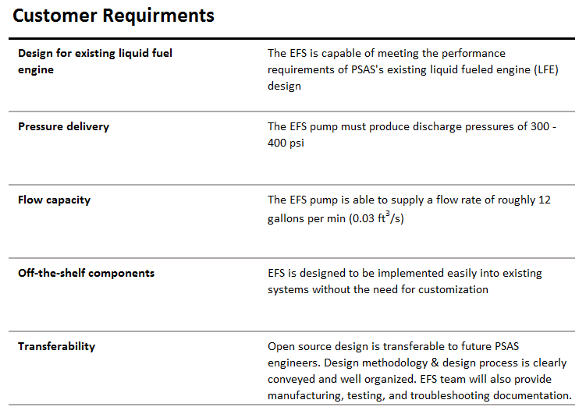
Portland State Aerospace Society | Electric Propellant Feed System
6
Notes:
6

Slide 7
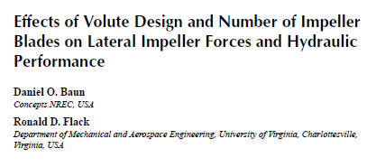
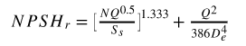
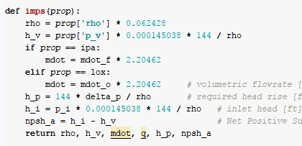
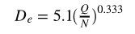
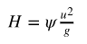
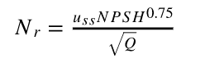
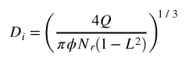
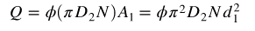
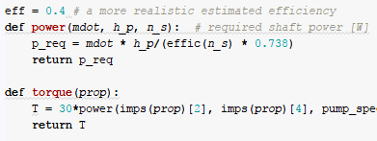

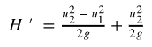
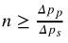
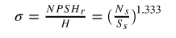
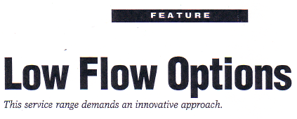
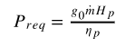
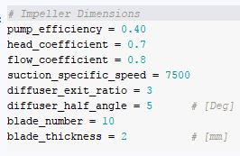
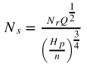
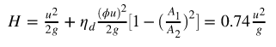
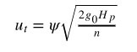
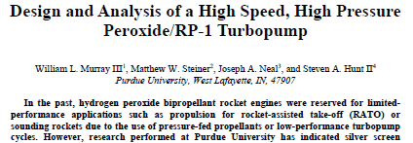
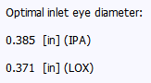
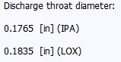
Open-ended literature review
Puzzle break
Scientific computing
We made some guesses too
7
Notes:
7

Slide 8
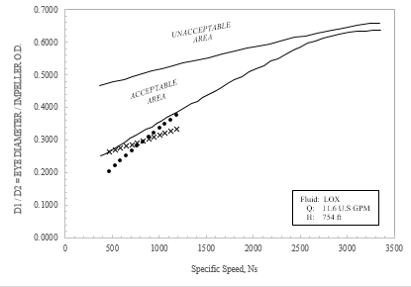
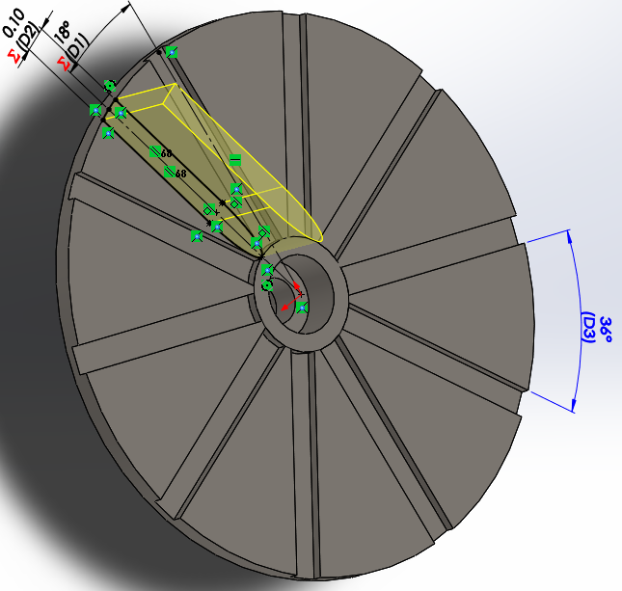
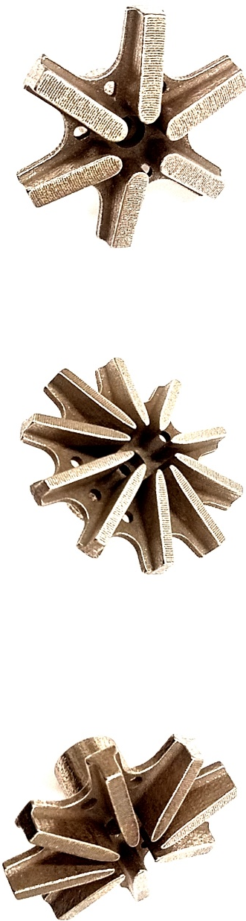
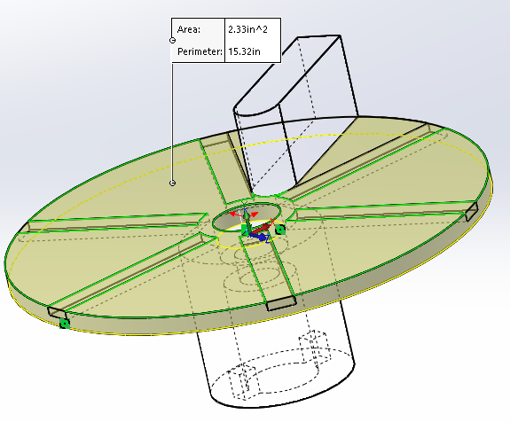
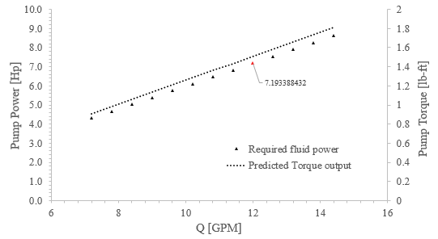
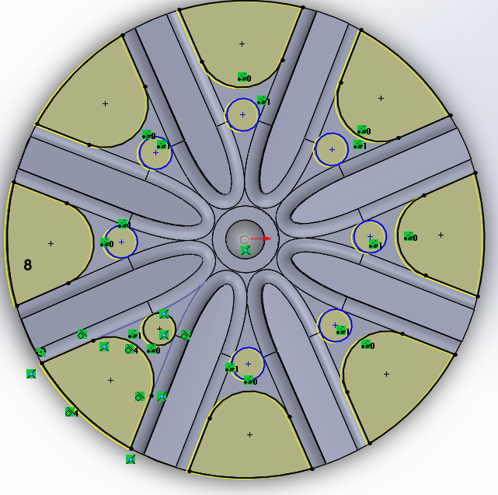
Map out predictions
Play with the design
Create something
You are here
8
Notes:
8

Slide 9
#5 Final Design and Subsystem breakdown
Delete slide before inserting into active

Slide 10
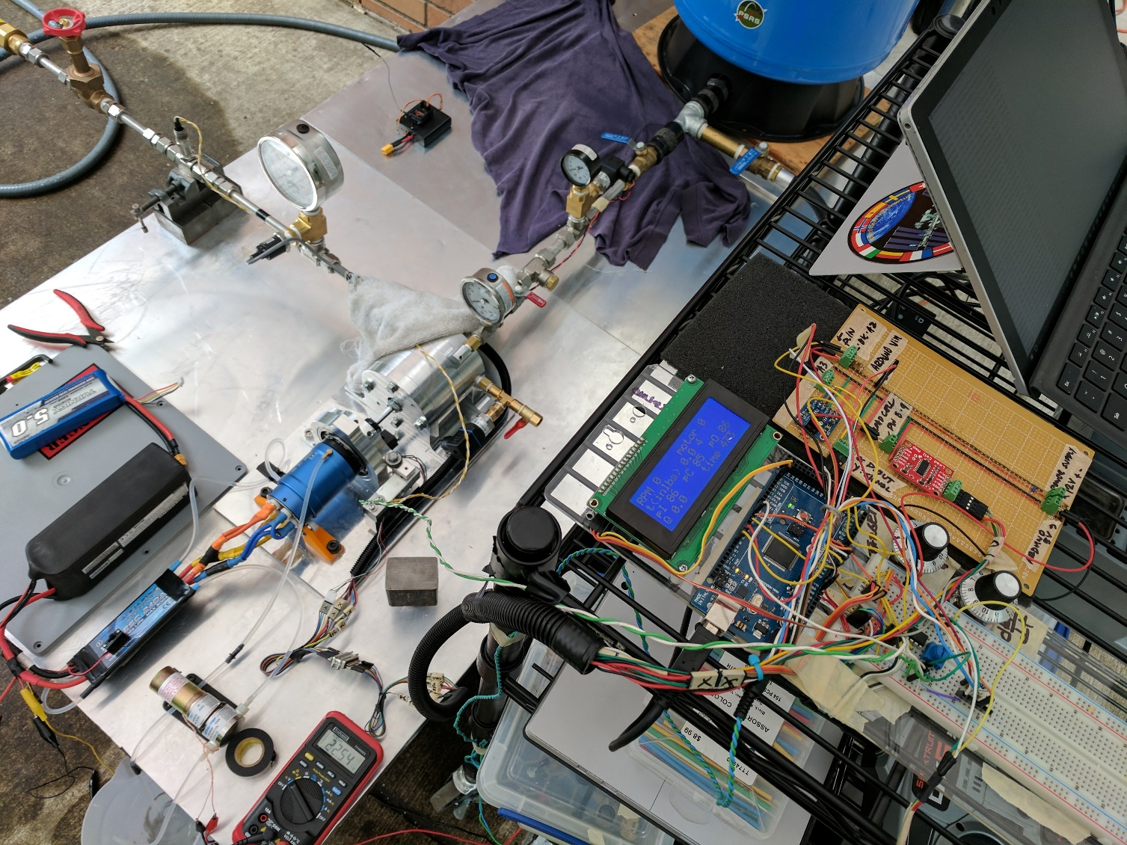
Final Design: Review
To insert:
Flow diagram of testing apparatus – Diagram
Actual Testing Assembly – High res photo
Notes:
look at the thing we created: a testing and development platform for an electric feed system
Portland State Aerospace Society | Electric Propellant Feed System

Slide 11
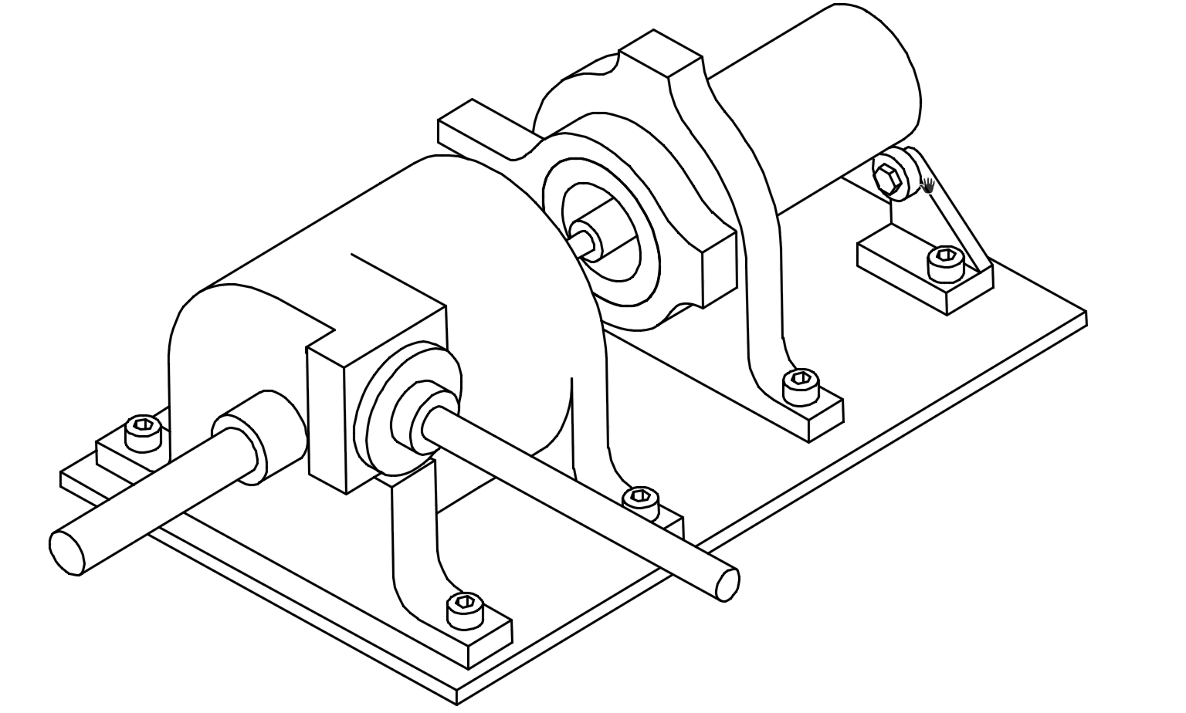
Electric Feed System
Pump
Testing
Casing
Drive
Flow Loop
Measurement
Hydraulic
Motor
Flow Loop
Pressure
Mechanical
Control
Air Pressure
Flow
Bearings
Batteries
Water
RPM
Seals
Dyno Mount
Seals
Torque

Slide 12
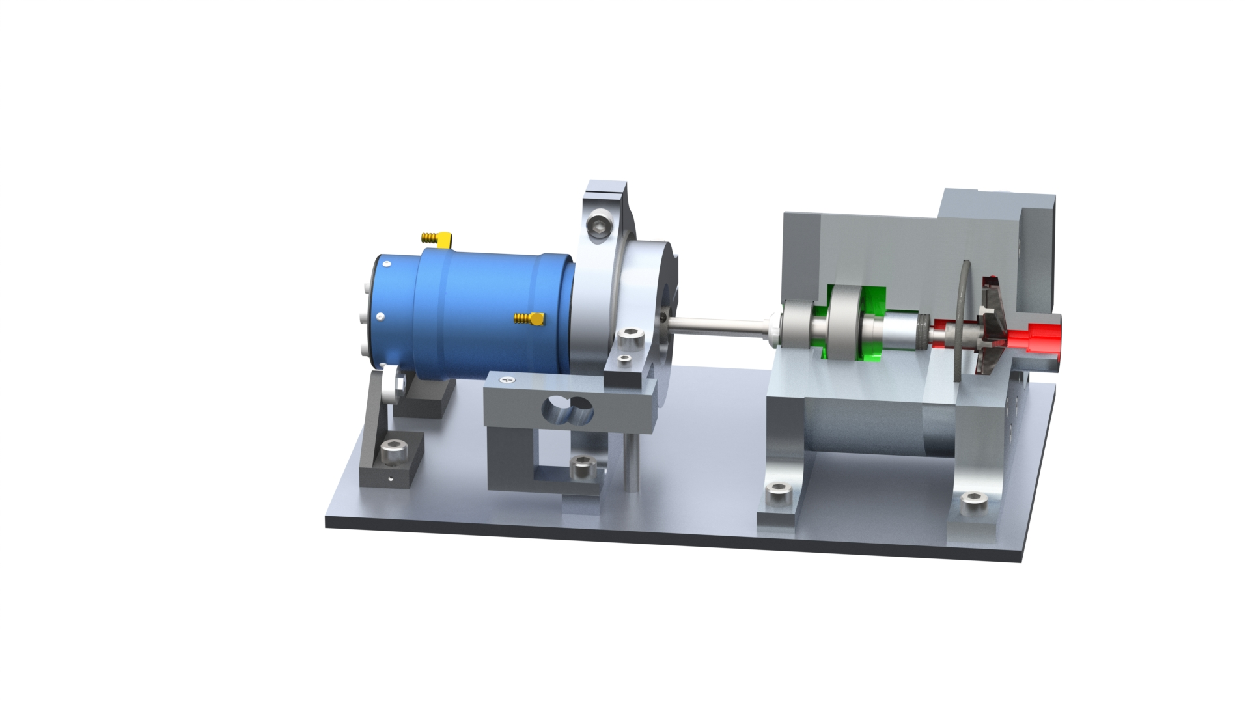
Notes:
Subsystem breakdown:
Pump:
Bearing system
Seal system
Hydraulic system ( volute, impeller, diffuser) – highlight modular design
Shaft
To insert:
Quarter section – CAD
Photo of the pump w/ casing – High Res
Final Design: Subsystem
Portland State Aerospace Society | Electric Propellant Feed System

Slide 13
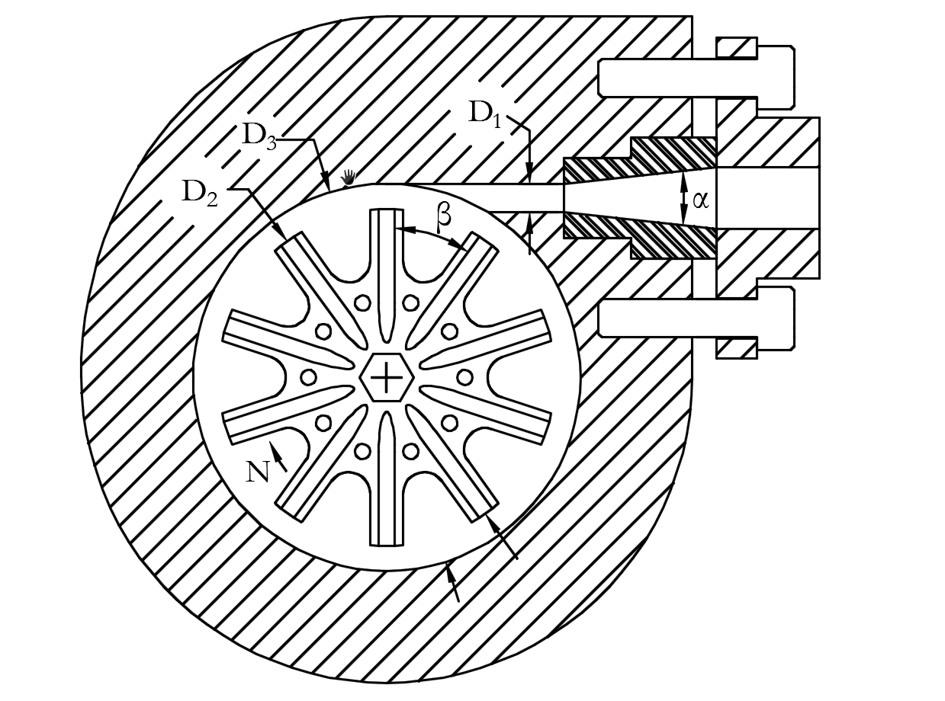
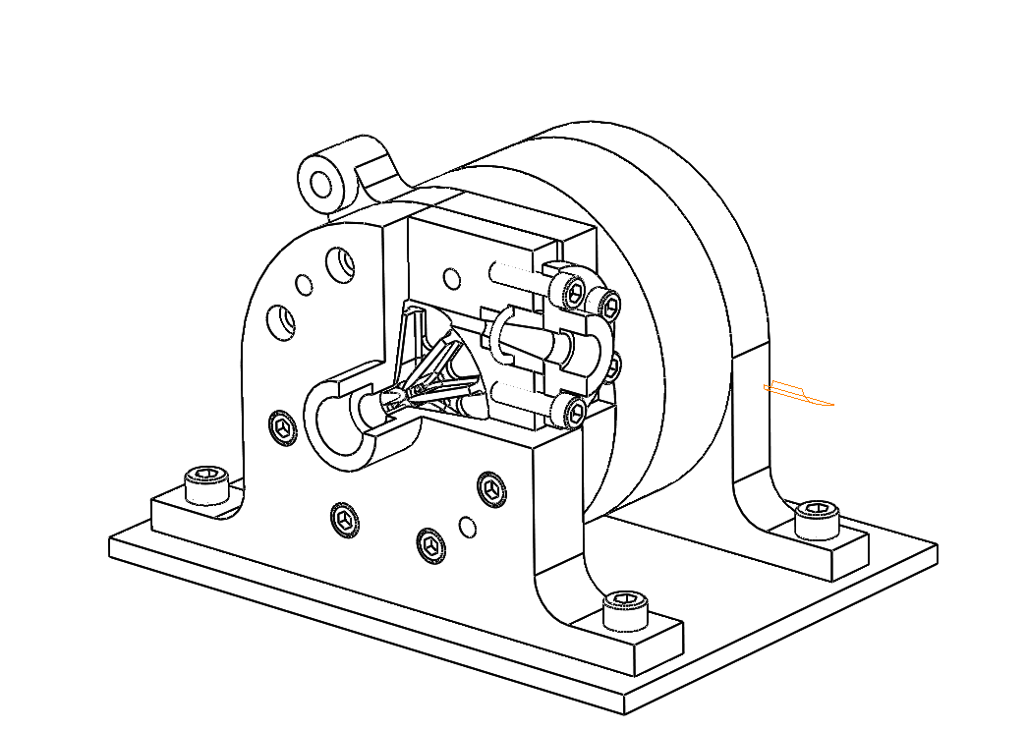
Notes:
Hydraulic design
To insert:
WIT
SECTION VIEW
Final Design: Review
Performance parameters of EFS partial emission pump
Discription |  |  | Value
Q (G.P.M) |  |  | 12
H (ft) |  |  | 754
N_{r} (r/min) |  |  | 20500
P (KW) |  |  | ≤ 3.5
Structure parameters of EFS partial emission pump
Discription |  |  | Value
Impeller Outlet Diameter D₂(in) |  |  | 2.1
Impeller Blade width b₂(in) |  |  | 0.2
Discharge Throat Diameter D₁(in) |  |  | 0.18
Impeller eye Diameter D_{e}(in) |  |  | 0.43
No. of Blades |  |  | 10
Impeller Discharge Angle β(̊) |  |  | 36
Base Diameter of Volute Caseing D₃(in) |  |  | 2.42
Length of Diffuser section L_{D}(in) |  |  | 1.2
Diffusion Angle α(̊) |  |  | 8
Portland State Aerospace Society | Electric Propellant Feed System

Slide 14
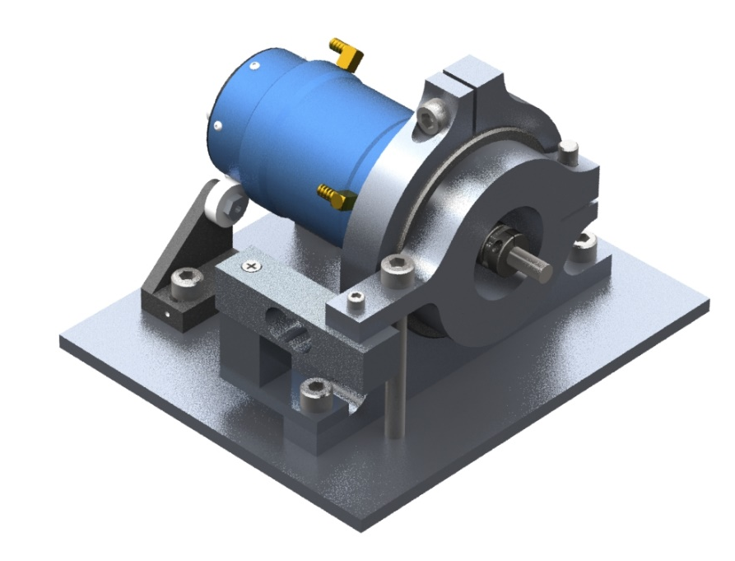
Notes:
Subsystem breakdown:
Drive:
Motor / esc / battery / control
Motor Dyno mount (floating torque measurement)
Motor coupling – Alignment and verifying runout (angular / offset)
To insert:
Rendering of the motor dyno – CAD
Photo or diagram of the motor
Final Design: Subsystem
Motor Dynamometer Mount
Portland State Aerospace Society | Electric Propellant Feed System

Slide 15
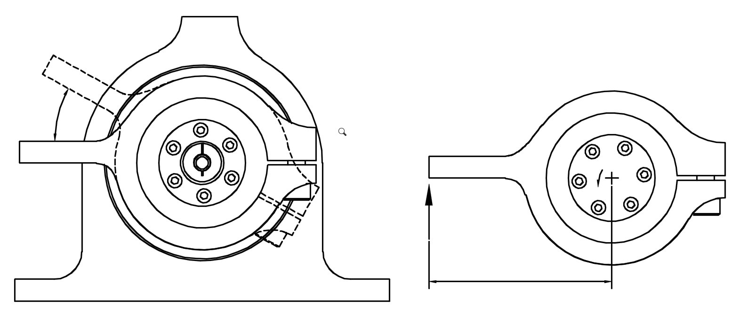
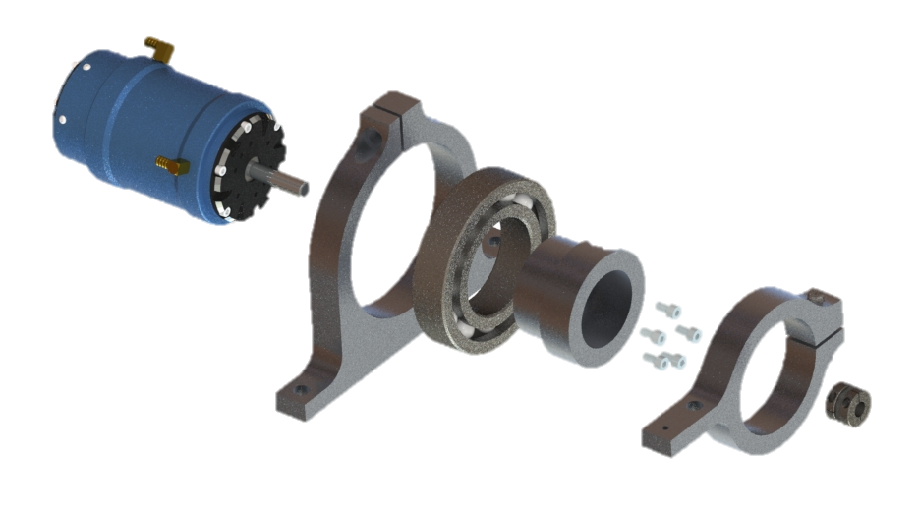
Notes:
Subsystem breakdown:
Drive:
Motor / esc / battery / control
Motor Dyno mount (floating torque measurement)
Motor coupling – Alignment and verifying runout (angular / offset)
To insert:
Rendering of the motor dyno – CAD
Photo or diagram of the motor
Final Design: Subsystem
Motor Mounting and Control
T
R
L
Portland State Aerospace Society | Electric Propellant Feed System

Slide 16
Final Design: Subsystem
To insert:
Flow diagram of testing apparatus – Diagram
Photo of the testing apparatus – high res photo
Photo of DAQ / measurement / harness
Notes:
Subsystem breakdown:
Testing Apparatus:
Tank, suction line, discharge, experimental procedure, cooling
Sensing
Pressure, flow, RPM, Torque
Data Acquisition
Arduino to excel
Currently not in use….
Portland State Aerospace Society | Electric Propellant Feed System

Slide 17
Challenges / Solutions: Fabrication

Slide 18
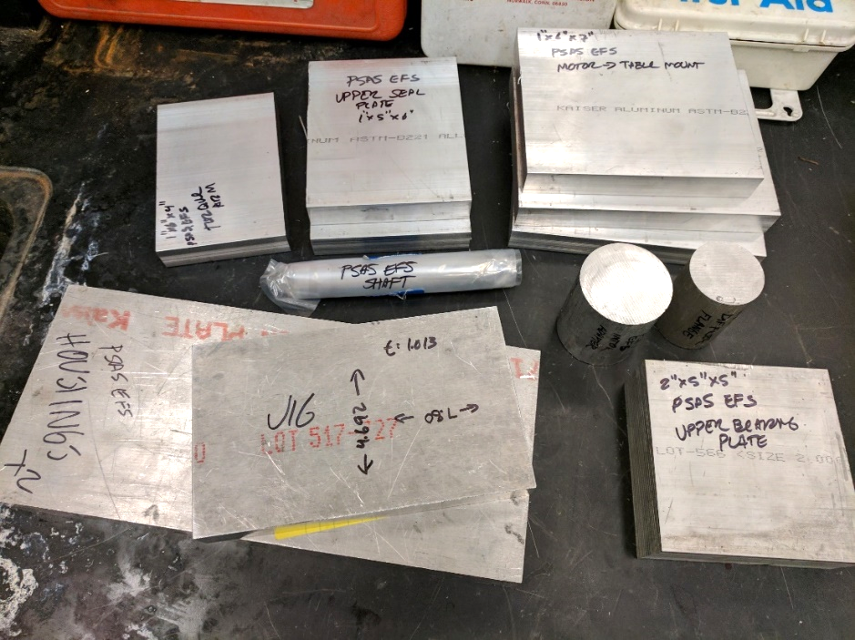
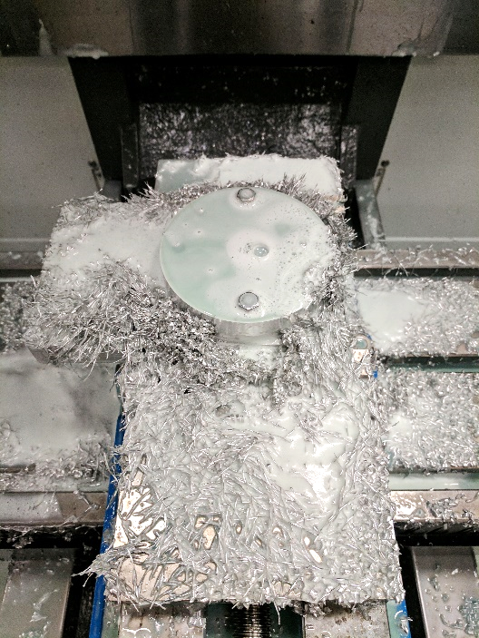
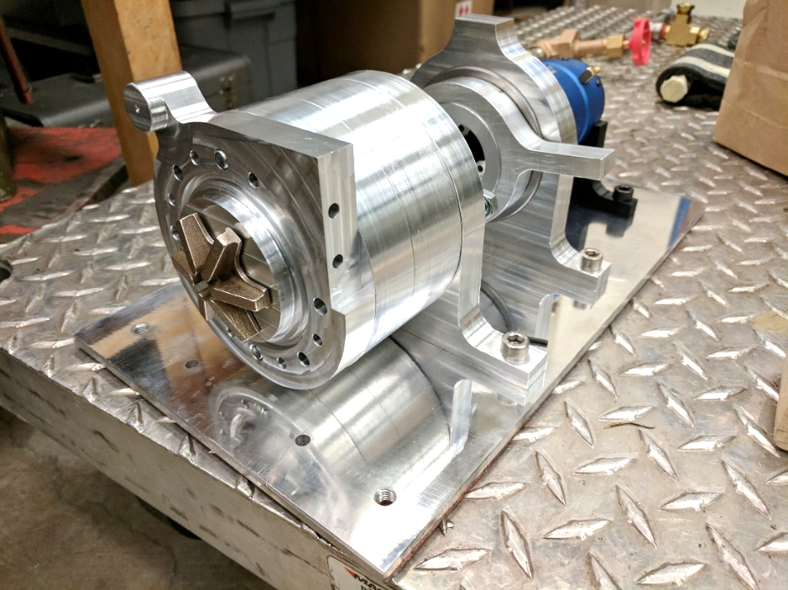
Challenge: Fabrication
Head v. flow requirements meant commercially available pumps wouldn’t work.
Outsourcing fabrication would be cost prohibitive.

Slide 19
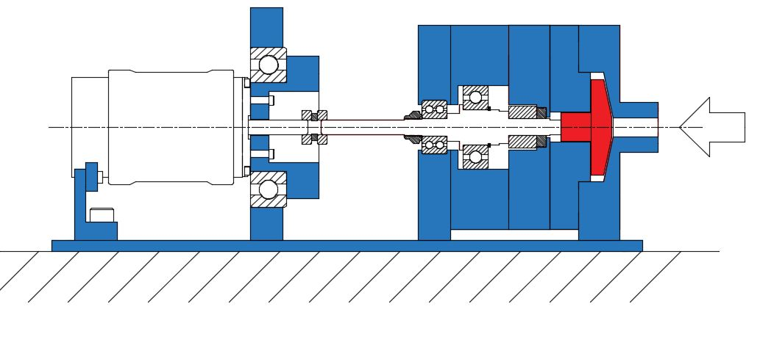



Challenge: Precision
High speeds and loads with low tolerances meant fabrication had to be precise.
+/- ~0.0007”
0.06” +/- 0.01”

Slide 20



Solution: Time investment
Designed parts around available fabrication techniques.
Learned 3-axis CNC mill and 2 axis CNC lathe.
Several thousand (wo)man hours in the shop.

Slide 22
Challenges
To insert:
Photo, highlight sensors
Photo, DAQ
Photo, Motor control
Notes:
2. Controls / Measurement
Problems:
Motor control
Sensing and measurement for performance curves
Solutions:
Quad Copter rigging / controller potentiometer tricking
Sensors
Arduino DAQ
Portland State Aerospace Society | Electric Propellant Feed System

Slide 23
Notes:
Unfinished pieces:
more robust (safe) controls system
more variation of impeller geometry
a method of manufacturing diffusers that can be extended to a lox design
What you learned:
we overbuilt the hell out of this pump
What should be done next:
Full suite of testing to inform the next design decisions.
optimize seals bearing and material selections for cryo/Lox
v2 ready for hot fire testing.

Slide 24

Unfinished Business: Controls and Safety
More robust (read safe) controls system
Clean up wiring
Either a dedicated transmitter set up or hard wired throttle control
Replace all gauges with data

Slide 25
Unfinished Business: Lessons
Pump is over-designed but for a reason

Slide 26



Next steps:
Design it for really fucking cold
Make FIRE!!!!
Full suite of testing

